Slide 1

Simplified Calculation of Bhattacharyya Parameters in Polar Codes
Reported by Jiahui Xiong
2020.10.31
延时符

Slide 2
01
Background
CONTENTS
02
Complementarity of Bhattacharyya Parameters
03
Advantages of the Algorithm

Slide 3
01
Background

Slide 4

Channel polarization
Polar codes
5G
achieve channel capacity
B-DMCS
Channel polarization
0
noise channels: transmit frozen bits.
channels
Channel capacity
1
No-noise channels: transmit information bits.
(Polarization unit)

Slide 5


Bhattacharyya Parameters
Simplified calculation
2. Bhattacharyya Parameters
4. Disadvantage
Bhattacharyya Parameters
BEC
Channel reliability
One: Sensitive for channel erasure Probability
Tow: Computational complexity is high
Bigger: bad channel
smaller: good channel
1.How to distinguish channels
3. Bhattacharyya Parameters in polar codes
Choose “good” channels to transmit information bits;
Choose “bad” channels to transmit frozen bits
But how to measure the quality of the channel?
Z
Z

Slide 6
02
Complementarity of Bhattacharyya Parameters

Slide 7
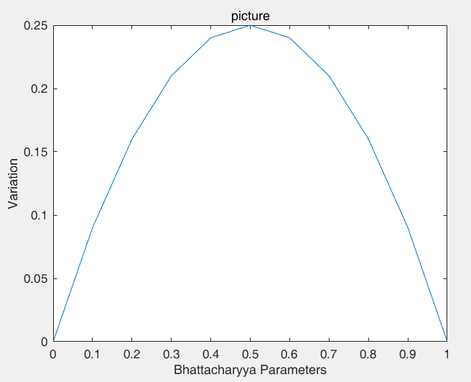
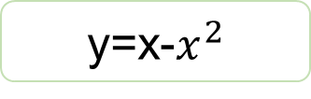
Variation of Bhattacharyya Parameters
y represents the variation after one polarization process; x represents the current Bhattacharyya parameter value, then
y=x-$x^{2}$
0.1503
“0”
0.09
“1”
Process ‘0’
Process ‘1’

Slide 8
Complementarity of Bhattacharyya Parameter
Calculating Bhattacharyya Parameter of Complementary Channel
A
0.1503
e=0.1
e=0.9
0.09
Process “0”
Process “1”

Slide 9
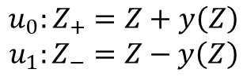
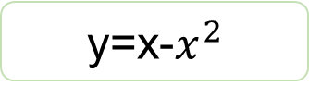
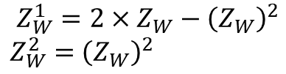
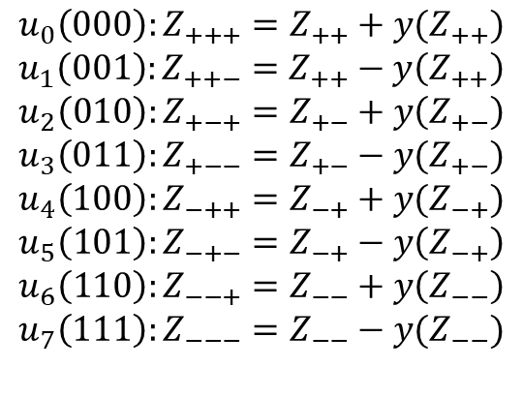
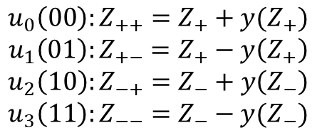
Calculating the Bhattacharyya Parameter under a Certain Channel Erasure Probability
y=x-$x^{2}$
For N=8,7 multiplications and 21 additions
N=2,
N=4
N=8
$$u_{0}\left(000\right):Z_{+++}=Z_{++}+y(Z_{++})$$
$$u_{1}\left(001\right):Z_{++−}=Z_{++}−y\left(Z_{++}\right)$$
$$u_{2}\left(010\right):Z_{+−+}=Z_{+−}+y\left(Z_{+−}\right)$$
$$u_{3}\left(011\right):Z_{+−−}=Z_{+−}−y(Z_{+−})$$
$$u_{4}\left(100\right):Z_{−++}=Z_{−+}+y(Z_{−+})$$
$$u_{5}\left(101\right):Z_{−+−}=Z_{−+}−y\left(Z_{−+}\right)$$
$$u_{6}\left(110\right):Z_{−−+}=Z_{−−}+y\left(Z_{−−}\right)$$
$$u_{7}\left(111\right):Z_{−−−}=Z_{−−}−y(Z_{−−})$$
$$u_{0}\left(00\right):Z_{++}=Z_{+}+y(Z_{+})$$
$$u_{1}\left(01\right):Z_{+−}=Z_{+}−y\left(Z_{+}\right)$$
$$u_{2}\left(10\right):Z_{−+}=Z_{−}+y\left(Z_{−}\right)$$
$$u_{3}\left(11\right):Z_{−−}=Z_{−}−y(Z_{−})$$
$$u_{0}:Z_{+}=Z+y\left(Z\right)$$
$$u_{1}:Z_{−}=Z−y\left(Z\right)$$
original method
$$Z_{W}^{1}=2×Z_{W}−{\left(Z_{W}\right)}^{2}$$
$Z_{W}^{2}=$ ${\left(Z_{W}\right)}^{2}$
For N=8,14 multiplications and 7 additions

Slide 10
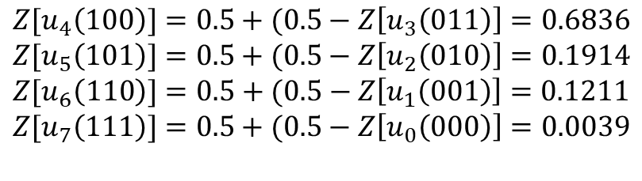
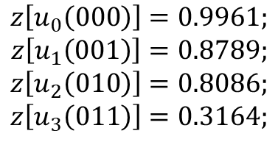
Calculating the Bhattacharyya Parameter under a Certain Channel Erasure Probability
Especially , the channel Bhattacharyya parameters is 0.5, The operation can be reduced by half according to the complementary
N=8, we can calculate
$$z\left[u_{0}\left(000\right)\right]=0.9961;$$
$$z\left[u_{1}\left(001\right)\right]=0.8789;$$
$$z\left[u_{2}\left(010\right)\right]=0.8086;$$
$$z\left[u_{3}\left(011\right)\right]=0.3164;$$
according to the complementary
$$Z[u_{4}\left(100\right)]=0.5+(0.5−Z\left[u_{3}\left(011\right)\right]=0.6836$$
$$Z[u_{5}\left(101\right)]=0.5+(0.5−Z\left[u_{2}\left(010\right)\right]=0.1914$$
$$Z[u_{6}\left(110\right)]=0.5+(0.5−Z\left[u_{1}\left(001\right)\right]=0.1211$$
$$Z[u_{7}\left(111\right)]=0.5+(0.5−Z\left[u_{0}\left(000\right)\right]=0.0039$$

Slide 11
03
Advantages of the Algorithm

Slide 12







calculating the Bhattacharyya parameters about the complementary channel
calculating the channel Bhattacharyya parameter under a certain channel erasure probability
Table 1
Table 2
 | multiplication | addition
Original method
Proposed method | 0
 | multiplication | addition
Original method
Proposed method
$$2(N−1)$$
$$N−1$$
$$2(N−1)$$
$$N−1$$
$$N$$
$$N−1$$
$$3(N−1)$$
In particular, if the channel Bhattacharyya parameter is 0.5, only half Bhattacharyya parameters of N channels need to be calculated

Slide 13


Thanks
延时符

